Slide 1
Optimized execution of parallel loops via user-defined scheduling policies
Seonmyeong Bak, Yanfei guo*, Pavan Balaji*, vivek sarkar
Georgia institute of technology
*Argonne National laboratory
Notes:
(VIVEK)
General comments:
1) Reduce text on slides
2) Aim for 24pt as the minium font size (you can go down to 18pt for sub-bullets if needed, but it’s preferable to minimize that) – see slide 3 as an example

Slide 2
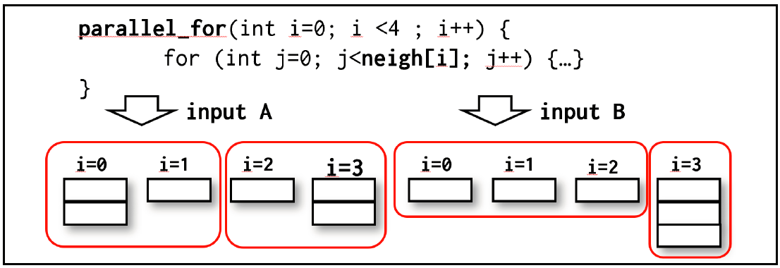
Motivation
Parallel loop is most common construct in parallel programming
It’s hard to execute sparse/dynamic loops which have varying number of iterations and load efficiently in parallel loop
Scheduling policies in most programming models cannot capture this variance efficiently
User knowledge on their loops can help this variance resolved
Previous works give more context to loop scheduling in many domains (e.g. GEMM, Graph)
Parallel programming models should have features to handle this variance in loop scheduling
2
Notes:
(VIVEK)
1) Changed title
2) You should verbally mention imbalance when you talk about this figure

Slide 3
Past Work
OpenMP has implemented many common loop scheduling policies
static, dynamic(P. Tang et al, ICPP 1986) and guided (C.D. Polychronopoulos et al, TC 1987)
Many efforts for both locality and load balancing have been proposed
The most common approach is to mix of static and dynamic: Each thread starts with some subspace where some of iterations are stealable by other workers (V. Kale et al, EuroMPI 2014)
These works couldn’t resolve some load balancing issue with locality completely
Each chunk may have different amount of load determined at runtime
This load imbalance is handled by unnecessary migration in the previous approaches
Notes:
(VIVEK)
Changed title and font size
Moved “our work” to next slide

Slide 4
This paper
Our work enables more optimal scheduling of loops with user information through our proposed API and runtime
A user function is used to decompose the iteration space of the target loop into subspaces
The other user function is used to create chunks within the subspace considering computation for each iteration
The created chunks are stored and retrieved for the future invocations of the target loop
We achieved up to 1.24x speed up in MiniMD, 1.47x in PageRank and 1.23x in Connected Components of GAP Benchmark suite
Notes:
(VIVEK)
Changed title
You should add a summary of results here as well

Slide 5
Overview of our approach
① Subspaces are selected by user-defined function or default configuration
Thread 0
Thread 1
Thread 2
Thread 3
0-20
21-40
41-60
61-80
② Chunks are created by user-defined function or default configuration
G
21
41-50
61-63
0-4
5-6
22-30
51-60
64-65
7-10
31-40
66-68
11-17
18-20
69-71
18-20
72-80
③ Each thread first consumes their local chunks and steals from others by work-stealing
④ Before consuming local chunks, the last thread to create all its chunks does concurrent load balancing for future invocations …
④ … and stores the result of load balancing in a hash map
- Hash-key = “src_loc:# of chunks: usr_ptr addr”, e.g., Hash (a.cpp:163:80:user_ptr)= 1
0
1
2
3
G
Hash index | Thread 0 | Thread 1 | Thread 2 | Thread 3
0-4
18-20
41-50
61-63
5-6
21
51-60
64-65
7-10
22-30
61-63
66-68
11-17
31-40
64-65
69-71
Thread 0
Thread 1
Thread 2
Thread 3
18-20
72-80
41-50
66-68
0-4
18-20
51-60
69-71
5-6
21
61-63
72-80
7-10
22-30
64-65
11-17
31-40
⑤ The next invocation retrieves the load balancing result from the hash map
- If the variables in the hash key don’t change -> Reuse the same subspaces repeatedly
5
Notes:
(VIVEK)
1) Moved this slide earlier and changed the title
2) Use this slide to define: subspace, user-defined scheduling, configuration
3) Add animation for (1), (2), (3), ….

Slide 6
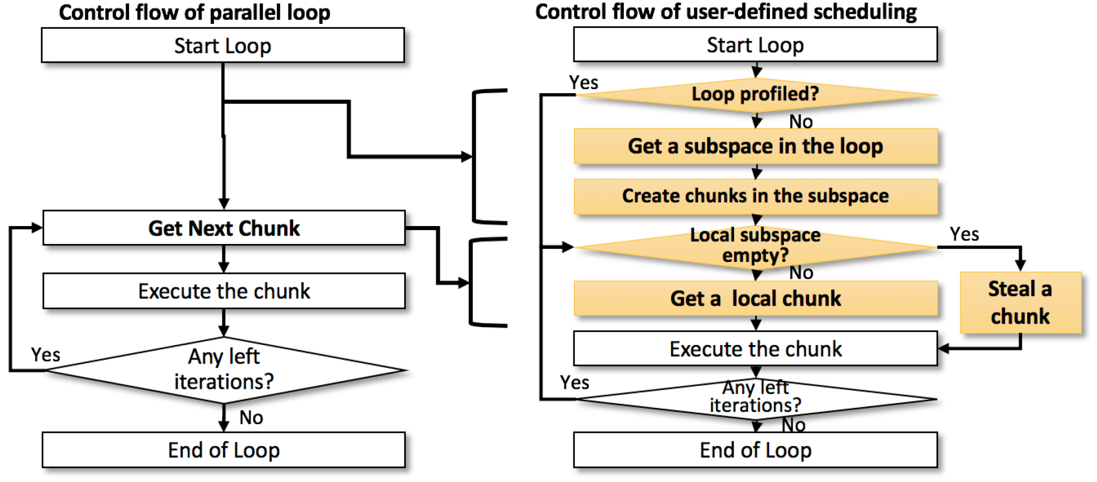
Control flow of user-defined scheduling
We changed the parallel loop in OpenMP from Work-sharing -> Workstealing
We made the control flow of OpenMP configurable with two user functions
Each thread gets subspace of the iteration space of the target loop by a provided user-function
With the other function, chunks are created within the assigned subspace
The chunks in each subspace are balanced concurrently during execution of the chunks
If the loop is profiled and invoked again with same data, stored balanced groups of chunks are retrieved without chunk creation

Slide 7
Example - PageRank with accumulating indegrees
Inspect_func accumulates indegree for each iteration in the outer loop
It creates a chunk if the accumulated number of indegree is higher than ‘threshold’
Here, the iteration space is decomposed to subspaces as many as the number of threads
Graph *g_ptr;
void inspect_func(int left_start , int left_end ,
int *assigned_start , int *assigned_end , void *user_data) {
int weight=0, iter=left_start;
do {
weight+=g_ptr ->indegree(iter++);
if (weight >=threshold) break;
/* Create each chunk when sum of indegrees reaches ' threshold ‘ */
} while (curr_idx < left_end);
*assigned_start=left_start , *assigned_end=curr_idx;
if (*assigned_end >=left_end) *assigned_end=left_end;
}
int subspace_select_func(int num_subspaces , void *user_data) {
return omp_get_thread_num(); //Each thread gets a subspace with its thread id
}
int main (void) {
g_ptr=&g;
ompx_set_usersched_for_loops(inspect_func , subspace_select_func ,
NULL , 1, 1, omp_get_num_threads());
#pragma omp parallel for schedule(runtime)
for (int i=0; i<g.num_nodes(); i++) {
...
for (NodeID v : g.in_neigh(u)) {...}
...
}
}
Notes:
(VIVEK)
Added line numbers to code example. You should refer to the line numbers when referring to the code.

Slide 8
Runtime Optimization – Workstealing Queue
If the target loop is profiled, then the stored groups of iterations are reused and pushed to local workstealing queue
Our workstealing queue supports bulk pop/steal as following
Dynamically increasing with list of queue blocks and each queue block consists of two subqueues
The first subqueue has bigger stealing block consisting of multiple chunks
The size of stealing block is size of a queue block / number of threads for OpenMP
The residual is pushed into the 2nd subqueue where the stealing block is just one chunk.
②-1 Head
②-2 Tail
②-3 Head
②-4 Tail
③
③
①
①
Tail array ptr
Head array ptr
⑥

Slide 9
Evaluation - Configuration
Machine configuration: 2 x Skylake 8180M Processor (28 C, 56 T) = 112 Hardware threads at JLSE in Argonne Nat’l Lab
Compiler and flags: Intel Compiler 18.0.1, -O3
Applications: MiniMD from Mantevo Suite; PageRank (PR), Connected Components (CC), BFS from GAP Benchmark Suite
# of threads: 56 threads for MiniMD (performance degraded with 112 threads); 112 threads for GAP benchmarks
Affinity configuration: KMP_AFFINITY=granularity=core,compact,1(MiniMD)/0(GAP),0 (compact affinity and neighbor threads are bound to each core – migratable across hardware threads within each core)
Loop schedules to be compared
Past work: static, and dynamic, guided, and static steal (mix of static / dynamic)
Our work: User defined scheduling w/ and w/o profiling (usersched, usersched(prof)) : User function which is similar to PageRank example is used. If profiling enabled, the chunks are balanced across threads and stored.
Chunk sizes and baseline
Found geomean best chunk size for each schedule on each app over different graphs.
Used static default (w/o chunksize specified) is used as a baseline
Notes:
(VIVEK) Added “Past work” and “Our work”. Updated Applicatiosn bullet

Slide 10
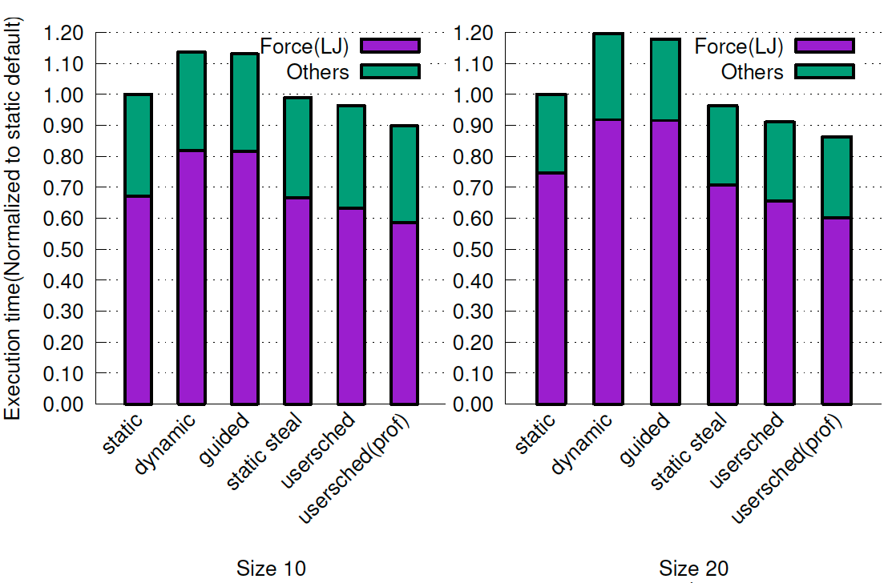
Evaluation - MiniMD
Lennard Jones(LJ) kernel is optimized using user functions similar to PageRank example
Limited load imbalance - naïve load balancing through guided / dynamic degrades performance
Static steal shows slight improvement compared to others
Usersched (prof) balances the imbalance by reusing stored balanced groups of chunks
Improved locality / load imbalance without overhead
In LJ, 24.0%, and 17.5% compared with static and static steal on size 20 input while 14.99%, and 13.81% with size 10

Slide 11
Evaluation – GAP Benchmark Suite
Graphs chosen for experiments(From SuiteSparse Matrix Collection(sparse.tamu.edu))
Apps chosen in the suite: Breadth First Search(BFS), Connected Components(CC), Page Rank(PR)
Triangle Counting(TC) has huge control divergence – Each conditional statement in each level of nested loops
Single Source Shortest Path(SSSP) and Between Centrality(BC) are implemented in push-based approach which keeps updating the active set of vertices by traversing the graph from top to bottom
BFS implementation in GAP suite uses a hybrid of pull and push-based approach
We only optimized the loop written in pull-based approach
BFS, PR and CC are optimized with user functions as described in the previous slide
Category | Wikipedia | Internet Topo | Patents Citation | Social Network | USA Road | Web Crawl
Graph | Wiki-2007 | Skitter | Patents | LiveJournal | Road | Web
# of Vertices | 3.57M | 1.70M | 3.77M | 4.00M | 23.95M | 50.64M
# of Edges | 45.01M | 22.19M | 16.52M | 69.36M | 57.71M | 1.93B

Slide 12
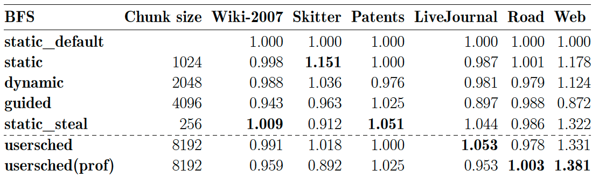
Evaluation – BFS (GAP Benchmark Suite)
Usersched / Usersched(prof) uses the number of accumulated innerloop iterations as chunk size
BFS shows limited improvement because only pull-based algorithm is optimized
The hybrid algorithm chooses between two approaches depending on the outdegree of the source vertex
Only Road / Web meets the heuristic to invoke pull-based algorithm
 | Chunk size | Wiki-2007 | Skitter | Patents | LiveJournal | Road | Web
static_default |  | 1.000 | 1.000 | 1.000 | 1.000 | 1.000 | 1.000
static | 1024 | 0.998 | 1.151 | 1.000 | 0.987 | 1.001 | 1.178
dynamic | 2048 | 0.988 | 1.036 | 0.976 | 0.981 | 0.979 | 1.124
guided | 4096 | 0.943 | 0.963 | 1.025 | 0.897 | 0.988 | 0.872
static_steal | 256 | 1.009 | 0.912 | 1.051 | 1.044 | 0.986 | 1.322
usersched | 8192 | 0.991 | 1.018 | 1.000 | 1.053 | 0.978 | 1.331
usersched(prof) | 8192 | 0.959 | 0.892 | 1.025 | 0.953 | 1.003 | 1.381
Notes:
(VIVEK) Changed title
Also use different color for usersched. Change from Latex to ppt/excel table?

Slide 13
Evaluation – PR, CC (GAP Benchmark Suite)
PR has improved significantly by repeated execution with stored balanced groups of chunks
47.3%, 13.5%, 18.9%, 8.8%, 4.9% and 5.8% for corresponding graphs over the best compared strategy (static steal)
CC is also improved by usersched as PR
22.7% compared with static steal on Skitter and shows 3~5% improvement on other graphs
Usersched runs with the same chunk size while static steal requires different chunk sizes for each app - stable performance with less tuning efforts
 | Chunk size | Wiki-2007 | Skitter | Patents | LiveJournal | Road | Web
static_default |  | 1.000 | 1.000 | 1.000 | 1.000 | 1.000 | 1.000
static | 256 | 5.099 | 2.402 | 1.167 | 2.512 | 0.681 | 1.059
dynamic | 512 | 4.083 | 2.240 | 1.175 | 2.538 | 0.663 | 0.819
guided | 1024 | 1.288 | 1.345 | 1.150 | 1.463 | 0.766 | 0.806
static_steal | 64 | 7.688 | 2.507 | 1.085 | 2.901 | 1.093 | 1.332
usersched | 8192 | 9.985 | 2.645 | 1.335 | 2.651 | 1.004 | 1.407
usersched(prof) | 8192 | 11.326 | 2.845 | 1.289 | 3.156 | 1.147 | 1.410
 | Chunk size | Wiki-2007 | Skitter | Patents | LiveJournal | Road | Web
static_default |  | 1.000 | 1.000 | 1.000 | 1.000 | 1.000 | 1.000
static | 1024 | 1.690 | 1.872 | 1.078 | 2.111 | 1.089 | 1.151
dynamic | 512 | 1.625 | 2.454 | 1.058 | 2.021 | 0.985 | 0.669
guided | 512 | 1.250 | 1.499 | 0.993 | 1.368 | 1.069 | 0.713
static_steal | 256 | 1.787 | 2.193 | 1.055 | 2.299 | 0.992 | 1.237
usersched | 8192 | 1.796 | 2.568 | 1.048 | 2.152 | 1.074 | 1.144
usersched(prof) | 8192 | 1.855 | 3.012 | 1.080 | 2.281 | 1.043 | 1.282
Notes:
(VIVEK) Changed title
Also use different color for usersched. Change from Latex to ppt/excel table?

Slide 14
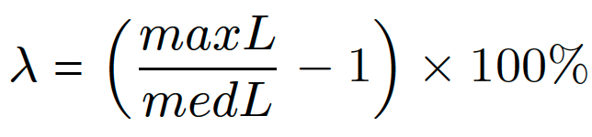
Evaluation - Load imbalance & Cache performance (PageRank)
The following metric is used to measure the amount of load imbalance
dynamic shows great reduction in this metric
The lower value doesn’t always result in better performance
Unnecessary migration of tasks can cause significant overhead and data locality loss
We measured cache performance with PAPI
We reduced cache miss, productive and other stall cycles significantly due to reduced load imbalance with keeping data locality
schedule | Wiki-2007 | LiveJournal | Skitter | Patents | Web | Road
static_default | 1242.310 | 245.320 | 327.263 | 56.938 | 111.484 | 26.136
static | 127.309 | 7.364 | 22.727 | 18.140 | 32.882 | 6.054
dynamic | 2.941 | 1.045 | 2.308 | 8.162 | 1.048 | 1.834
guided | 106.489 | 18.182 | 21.552 | 9.026 | 1.004 | 0.477
static_steal | 4.878 | 1.271 | 10.702 | 28.717 | 37.324 | 2.559
usersched | 4.331 | 1.674 | 16.190 | 7.272 | 17.506 | 2.518
usersched(prof) | 2.155 | 1.843 | 6.762 | 13.157 | 11.813 | 2.712
Load imbalance factor of PageRank(%)
schedule | Cache miss | Productive | Other stall | Total
static_default | 0.0439 | 0.1630 | 0.7931 | 1.0000
static | 0.0586 | 0.0354 | 0.1147 | 0.2087
dynamic | 0.0683 | 0.0372 | 0.1251 | 0.2306
guided | 0.0599 | 0.1216 | 0.5722 | 0.7537
static_steal | 0.0566 | 0.0225 | 0.0451 | 0.1242
usersched | 0.0652 | 0.0164 | 0.0073 | 0.0889
usersched(prof) | 0.0554 | 0.0152 | 0.0037 | 0.0743
Normalized performance counter results with Wiki-2007

Slide 15
Applicability to DSLs (GraphIt) – Evaluation of PageRank
Graph is most popular domain for DSLs and GraphIt(OOPSLA `18) is most recent work which outperforms previous works and generates OpenMP codes
We generated PageRank OpenMP codes from GraphIt w/ and w/o segmentation
GraphIt has separate interface for algorithm and scheduling of graphs
We compared this PR with GAP PageRank and applied user-defined scheduling
Usersched improved PR with segmentation
48.9 % and 58.5 % on Wiki-2007 and LiveJournal
User-provided information in DSL can be used to create user functions for more optimal schedules
Wiki-2007 | GraphIt | GAP | LiveJournal | GraphIt | GAP
segmentation | 4.840 |  | segmentation | 1.639
static default | 1.000 | 1.096 | static default | 1.000 | 1.316
static | 5.127 | 5.590 | static | 2.130 | 3.307
dynamic | 5.576 | 4.476 | dynamic | 2.018 | 3.341
guided | 1.271 | 1.412 | guided | 1.320 | 1.926
static_steal | 4.802 | 8.428 | static_steal | 2.419 | 3.819
usersched | 7.193 | 10.947 | usersched | 2.357 | 3.490
usersched(prof) | 7.210 | 12.416 | usersched(prof) | 2.598 | 4.154
Notes:
(VIVEK) Changed title
Also use different color for usersched. Change from Latex to ppt/excel table?

Slide 16
Summary
Optimal schedules for parallel loops are dependent on runtime variables such as input datasets
Our proposed APIs enable users to define how to create each chunk with knowledge on the target loops
Our runtime system stores the balanced groups of chunks created with user functions in a hash map for future invocations efficiently
Our work improved MiniMD in Mantevo Suite up to 1.24x and, PageRank and Connected Components in GAP Suite up to 1.47x and 1.23x
Our approach can be applied to high-level DSLs if their generated OpenMP codes are called repeatedly as in PageRank codes from GraphIt
Notes:
(VIVEK) Changed title

